Slide 1
EY Techathon 4.0 Executive Summary
Date of submission: 15/10/2023

Slide 2
MORE ABOUT OURSELVES
TEAM NAME : BAYMAX
COLLEGE:SAHRDAYA COLLEGE OF ENGINEERING AND TECHNOLOGY
TEAM MEMBERS:
JOEL JAISON – BACKEND , AI DEVELOPER
VIVEK K J – FULL STCK WEB DEVELOPER
HARIS JOSIN PETER – FLUTTER ,FIREBASE LEONARD KB – FRONT END
RABIN FRANCIS- PRESENTATION,UI/UX

Slide 3
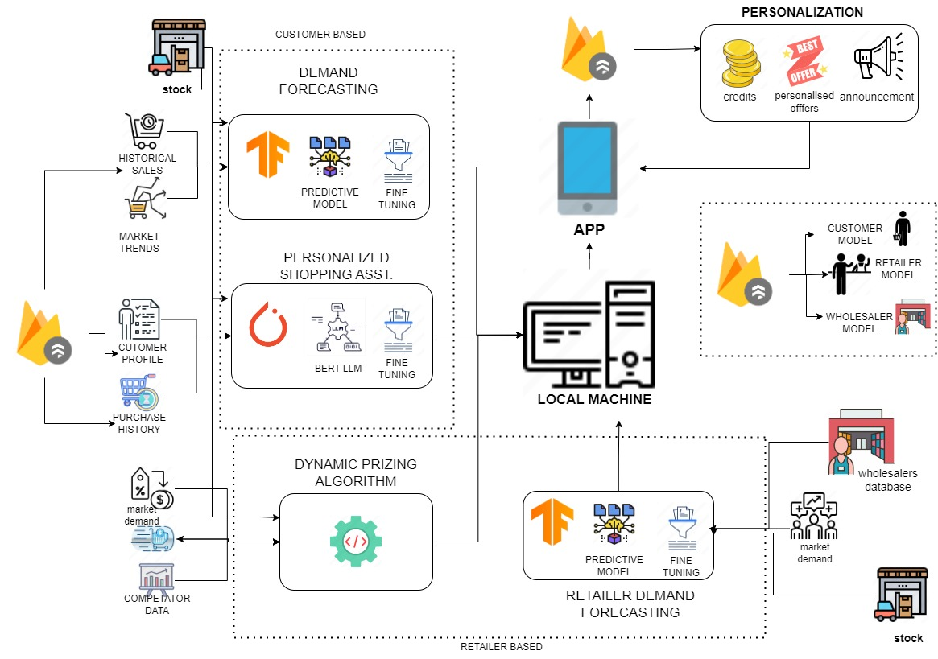
PROBLEM STATEMENT AND SOLUTION
PROBLEM STATEMENT : enhancing retail with generative Ai: predictive analytics and personalized recommendations
SOLUTION:
By leveraging TensorFlow's predictive models and fine-tuning capabilities, businesses can gain valuable insights from historical sales data and adapt to evolving market trends for more accurate demand forecasting.
To implement a recommendation system on the retailer side, leverage customer data, collaborative filtering, and machine learning algorithms to offer personalized product suggestions, enhance the shopping experience, and drive sales.
enhance customer engagement, fostering loyalty and driving sales in an ever-evolving e-commerce landscape.
Utilize market demand, store-specific stock levels, and insights from wholesalers to provide intelligent retailer suggestions, optimizing inventory management and aligning stock availability with market, store, and supply chain dynamics.

